Slide 1




PROJECT
PRESENTATION
Presented by: Nay Win Hlaing, Khin Su Myat Moe
ConvNext Group

Slide 2


Transformers see long-range relationships in images
Transformer-inspired
Redesign of ResNet ideas

Slide 3
USE CASES
FIELDS
High-accuracy classification tasks
Fine-grained recognition
Image captioning (as backbone)
Transfer learning in modern applications
Autonomous vehicles
AI startups
Computer vision R&D
Next-gen mobile vision apps

Slide 4

CONVNEXT VARIANTS
ConvNeXt-Tiny
ConvNeXt-Base
ConvNeXt-Small
ConvNeXt-Large
ConvNeXt-XL

Slide 5
ARCHITECTURE
Each block :
Kernel - 7 x 7
GELU Activation
Residual connection (ResNet)
Layer Normalization (Transformers)
Depends on features instead of batch size
More accurate, stable, faster in training
Depthwise Convolutions
1 filter per input channel
Keeps spatial info
Fewer downsampling steps
Preserves more details and spatial info
4 stages (ResNet)
Total 18 blocks - [3,3,9,3]
Helps learn features gradually at different scales

Slide 6
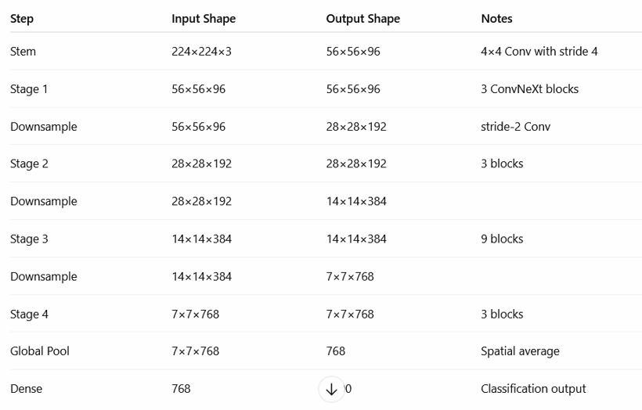

Slide 7
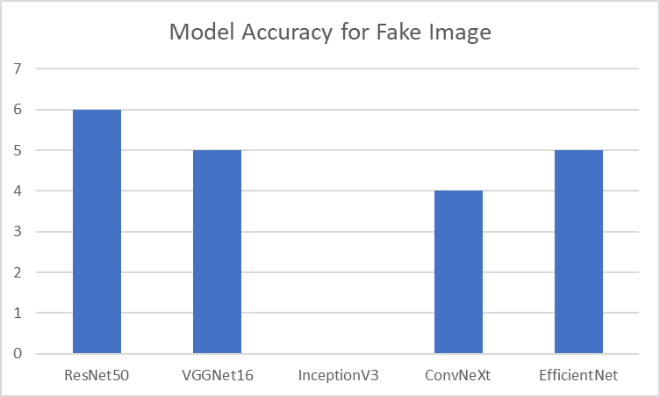
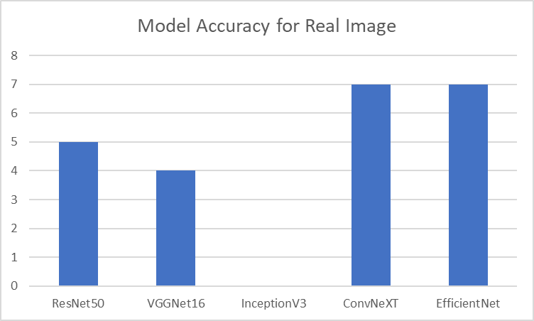
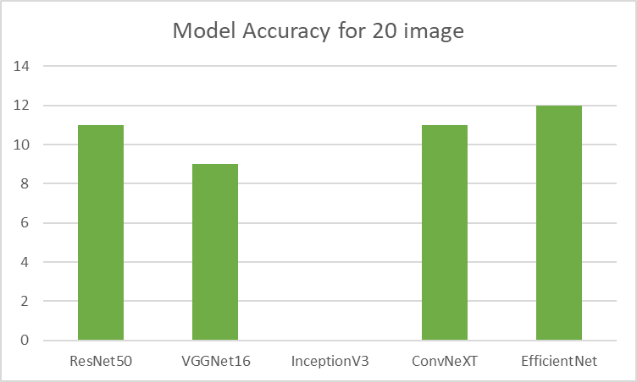

Slide 8
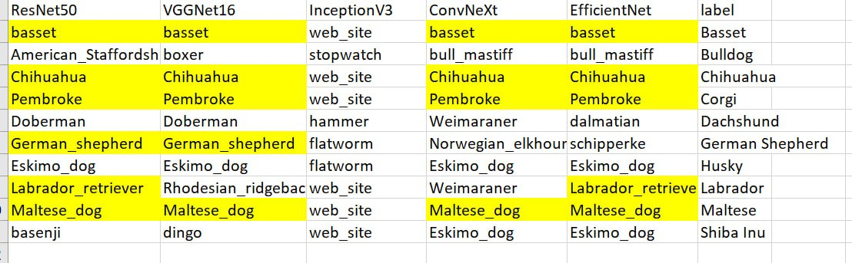
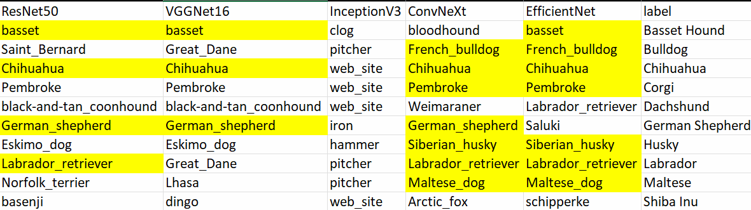
Synthetic Picture Prediction
Real Picture Prediction

Slide 9
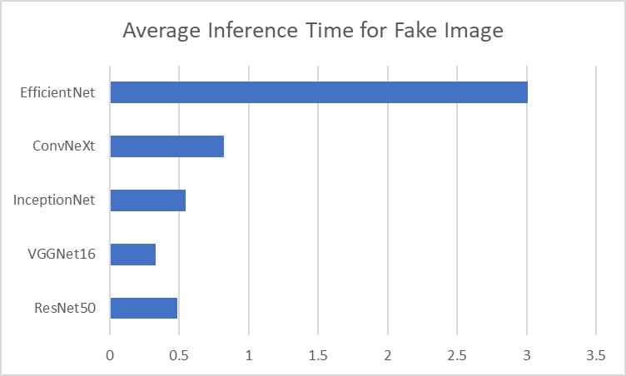
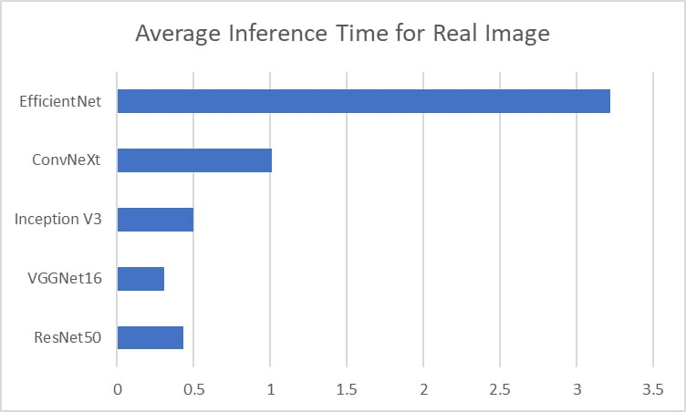

Slide 10

OBESRVATION OF
TOP 3 PREDICTIONS
Shiba Inu & Dachshund: Neither synthetic nor real images ranked in top-3 for any model.
German Shepherd: EfficientNet failed to include it in top-3 for both image types.
When the correct label is NOT the top prediction - Synthetic Images Show Higher Top-3 Consistency Than Real Images

Slide 11

CONCLUSION
EfficientNet - Lowest Speed with Highest Accuracy
VGGNet - Highest Speed with 2nd Lowest Accuracy
Inception - No Accuracy
Covnext performs better on real images - Training data is based on real world images.

Slide 12
THANK YOU

